Slide 1
CISCO case study
Mentor: Prof. Ratnakar Pandey
Presented By:
Anand Mohan
Nagesh V
Sana Shakeel
Vaibhav Tyagi

Slide 2
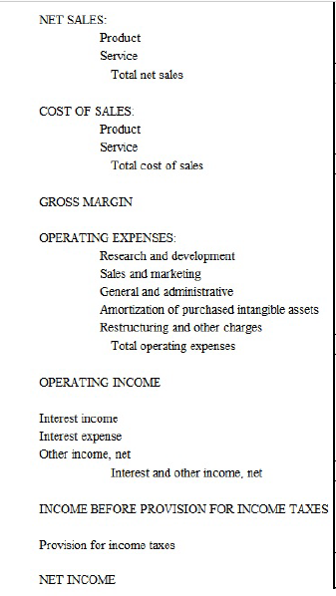
Cisco Presentation:
Business Objective:
Use Financial and Statistical knowledge to make a forecast about the ‘Net Income’ and other line items. We Need to project our forecast for the next 2 quarters and related confidence level.
Known facts about the data:
we have 25 quarters data depicting the financial health of Cisco under various heads namely
NET SALES,COST OF SALES,GROSS MARGIN,OPERTING EXPENSES, OPERATING INCOME,INCOME BEFORE TAX AND NET INCOME.

Slide 3
Cisco Presentation:
EDA and Visualization of the data and insights:
We plotted pair plots, box plots, created pivot table and also plotted correlation among the variables. Insights were shared on the following HTML file.
Data Cleaning and Feature Engineering:
Since we have only 25 quarters data depicting the financial health of Cisco we have tried to use all the data values except the values for which we had missing values. We imputed them with -1 as we can’t afford to delete the rows with missing values for the present dataset. we employed PCA Modeling by transforming existent 21 variables into 5 variables such that these variables are not inter correlated to solve multi collinearity issues and here we can see that if we choose 5 variables for building PCA models, the 87.9% variance in the output variables gets explained by these 5 variables.

Slide 4
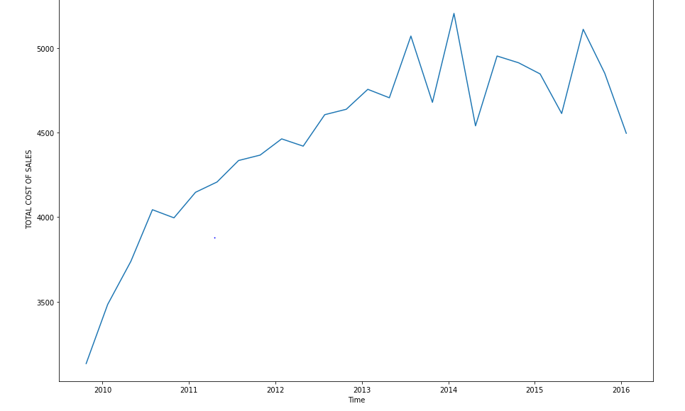
Cisco Presentation:
Possible explanation of the trends for each variable and business interpretation:
We have plotted the trends and shared the findings and the plots on the HTML file for which the links are shared in slide2 of our presentation.
Summarizing the trends as below:
OVERALL COST OF SALES:
product cost shown an upward trend year over year and reached its peak in 2014. product cost came down in 2015 and further went down in 2016. services cost shown a continuous upward trend barring minor corrections here and there which was pretty disturbing. Total cost of sales over time shown downward trend wherever the product product costs came down otherwise it was ever increasing. Service cost need to be controlled as it has ever been towards increasing trends. Product cost was coming down in 2015 and then further improved in 2015.hence,steps must be taken to maintain the same trend thereby reducing the overall cost of sales.

Slide 5
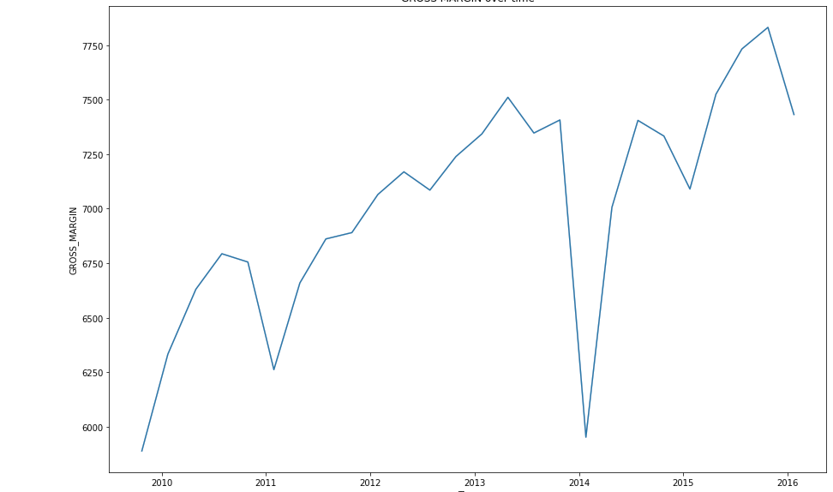
Cisco Presentation:
Possible explanation of the trends for each variable and business interpretation:
Summarizing the trends as below:
Gross Margin
Gross Margin looked to show a healthier upward trend with minor downward glitches here and there till 2014.However as we know the product cost reached its peak in 2014 and service cost was ever increasing year on year. Product sales seen the lowest downward peak in 2014.ultimately due to product sales reaching the lowest peak and product cost going up had its impact on Gross Margin. Gross Margin saw the lowest peak in 2014.however,it had shown improvements going forwards in 2015 and then in 2016 and was able to regain much of its lost grounds by the end of 2016.

Slide 6
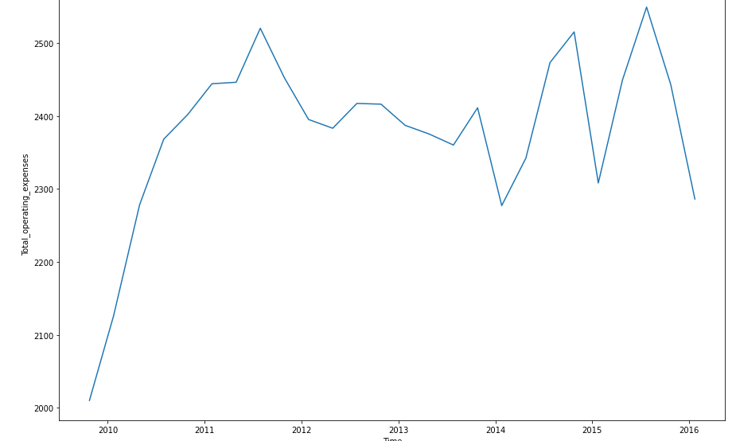
Cisco Presentation:
Possible explanation of the trends for each variable and business interpretation:
Summarizing the trends as below:
Total operating cost:
The company spent considerable money in R and D till 2014. The R & D expenses dipped down to lowest tip in 2014 and then company realized its mistakes and thereby increased R&D expenses going forwards in 2015 and then again in 2016.kindly note that company gross margin had hit the lowest bottom and reducing expenses in R&D might had been one of the factors. sales and marketing cost was going up till 2011.however we couldn't see any upward or downward trend going further 2011 and it almost seemed to plateau from 2011 up till 2016 which looked to be quite positive. Total operating cost was in an upward trend till 2011 and then it remained around the same zone going forward from 2011 up till 2016.This was overall a good sign. However, the company is advised to keep maintaining the same R&D initiatives year on year as that would only help the company to innovate and prosper further more in coming years.

Slide 7
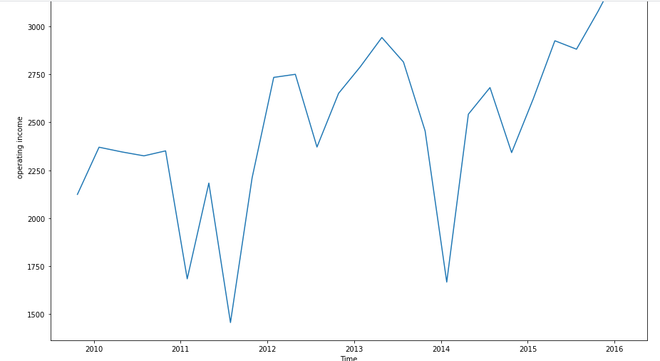
Cisco Presentation:
Possible explanation of the trends for each variable and business interpretation:
Summarizing the trends as below:
Total operating income:
operating income shown a continuous upward trend since 2014 onwards till 2016. The company had seen its operating income going down from 2010 to 2012 and then fluctuating quite a lot from 2012 till 2014.Hence,company must try to find reasons and learn its lesson from the downfall that happened in 2010-2012 and then sharp fluctuations which it had seen from 2012 till 2014.

Slide 8
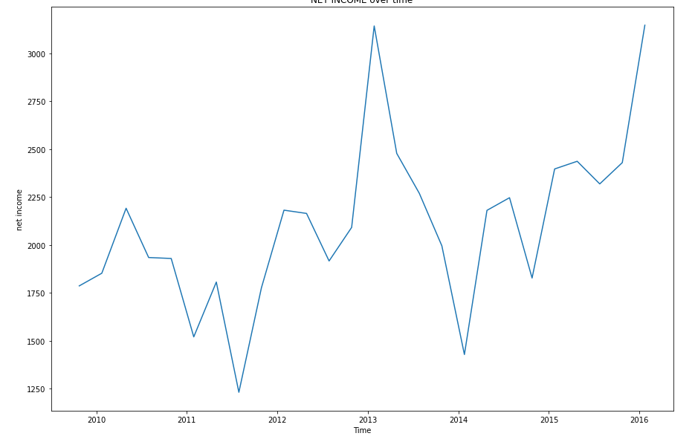
Cisco Presentation:
Possible explanation of the trends for each variable and business interpretation:
Summarizing the trends as below:
Total Net income:
Net Income shown a continuous upward trend since 2014 onwards till 2016. The company had seen its Net Income going down from 2010 to 2012 and then fluctuating quite a lot from 2012 till 2014. Hence, company must try to find reasons and learn its lesson from the downfall that happened in 2010-2012 and then sharp fluctuations which it had seen from 2012 till 2014.

Slide 9
Cisco Presentation:
Analytical Approaches considered:
Building RandomizedSearchCV Models on 5 variables transformed from 21 variables via PCA Modeling we get the Predicted values For Net income. Using the predicted values for net income we will try predicting the net income for the next 2 quarters and related confidence level.
Predictive Tools and techniques considered and finally used:
We have used ARIMA Time series Modelling,facebook prophet modelling both with simple Net income variable and using the log of the Net income variable and tried to predict the net income atleast for the next 2 quarters.
Models and significance or accuracy of the model: Building Arima_model using Auto Arima we got error as 451.47 which is quite high. Here we tried predicting net income for atleast 2 quarters ahead.
Building Facebook Prophet Model we got error as 179.85 which is quite an improvement considering previous error of 451.47 obtained by building the ARIMA model. Here we tried predicting net income for atleast 2 quarters ahead.
Building Facebook Prophet Model by taking logs we got error as 137 which is still quite an improvement considering previous error of 179.85 obtained by building the Facebook prophet model without using logs. Here we tried predicting net income for atleast 2 quarters ahead.

Slide 10
Cisco Presentation:
Recommendation with the data backing and next steps:
we can see from the overall graph for net income that with the data available the error obtained while predicting a time series model for Net income remains quite high using any of the above methods.hence,going forward we can say that the Models does not seem to give very conclusive prediction inspite of the fact that the trend is on an increasing path and in an self correcting mode ever since the time when NET INCOME GRAPH had hit the lowest bottom in 2014.
Building various predictive time series Models and error estimation were shared on the following HTML file.

